Slide 1
Energy Scenario in India

Slide 2
CONTENT
Introduction
The Primary Energy Resource Endowment
Present Status of Development of Energy Resources
Changes in the Pattern of Primary Energy Supplies
Primary Energy Import
Renewable Energy
India's Renewable Energy Future Prospects
Energy Scenario up to the Year 2020
Estimates of Energy Requirement up to the Year 2020
Conclusion
Reference

Slide 3
INTRODUCTION
The Indian is fourth large energy consumer in the world.
The traditional fuels are gradually getting replaced by the commercial fuels such as coal, lignite, petroleum products, natural gas and electricity.
There is essential to look into the alternatives available for sustainable development.
Before the perspective of energy demand and supply is discussed, it may be useful to understand the nature of physical resource endowments of the country and their present status of development

Slide 4
The Primary Energy Resource Endowment
The current assessment in regard to the primary commercial energy resources indicates that coal is the major energy resource of the country.
The gross reserves of coal are presently estimated at around 301.05 billion tonne(MT).
There are some lignite deposits which are estimated to be more than 43.24 billion tonne(MT).
The estimated reserve of crude oil is 762.74 billion tonne(MT).

Slide 5
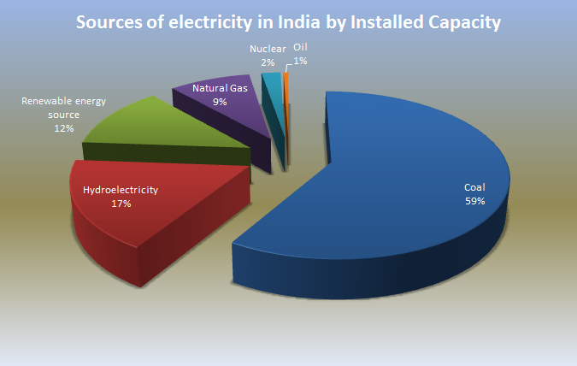
Present Status of Development of Energy Resources
Through the last decades, the country has taken major strides in stepping up the production of primary commercial energy as shown in Fig.

Slide 6
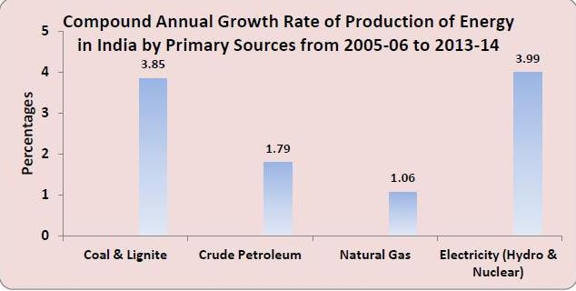
Considering the trend of production from 2005-06 to 2013-14, it is observed that coal production in India was about 407.04 MTs during 2005-06, which increased to 565.77 MTs during 2013-14 with a CAGR of 3.73%.
The Lignite production during the same period decreased by 4.70%.
During the same period the CAGR of Lignite was about 4.33% with production increasing from 30.23 MTs in 2005-06 to 44.27 MTs in 2013-14.
Production of crude petroleum increased from 32.19 MTs during 2005-06 to 37.79 MTs during 2013-14, a CAGR of about 1.80%.
The CAGRs for natural gas and electricity were 1.06% and 3.99% respectively.
❖

Slide 7
Changes in the Pattern of Primary Energy Supplies
PRIMARY ENERGY | DURING 2005-06 | DURING 2013-14 | CAGR (Compound Annual Growth Rate)
ELECTRICITY | 145755 MW | 284634 MW | 7.72%
COAL | 407.04 MT | 571.89 MT | 3.86%
LIGNITE | 30.23 MT | 43.90 MT | 40.23%
CRUDE OIL | 130.11 MT | 222.50 MT | 6.14%
At the end of March 2014,
The share of Nuclear energy was only 1.68% (4.78 GW)
Hydro power plants come next with an installed capacity of 40,531 MW, accounting for 14.24% of the total installed Capacity.
Non-utilities accounted for 13.83% (39,375MW) of the total installed generation capacity.
The highest CAGR (9.46%) was in case of Thermal utilities followed by Nuclear (3.99%) and Hydro (2.55%).

Slide 8
Primary Energy Imports
ENERGY MATERIAL | DURING 2005-06 | DURING 2013-14
COAL | 36.60 MT | 166.29MT
CRUDE OIL | 99.41 MT | 189.24 MT
PETROLEUM | 13.44 MT | 16.72 MT
Primary Energy Export
ENERGY MATERIAL | DURING 2005-06 | DURING 2013-14
COAL | 1.99 MT | 2.15 MT
PETROLEUM PRODUCTS | 23.46 MT | 67.86 MT

Slide 9
Renewable Energy
Energy that comes from the sources which are continuous replenished such as sunlight ,wind,rain ,tides, waves and Geothermal energy.
It has been estimated that India's renewable energy production amount to be total of over 100000 MW.
The annual turnover of India's renewable energy Industry is estimated to be about US $ 10 Billion.
Wind power alone contributes 68% of the entire country's renewable power.
About 16% of global energy comes from renewable resources.
10% of all energy from traditional biomass & 3% new renewable.
Electricity generation from renewable represents about 3% of all electricity generation in India.

Slide 10
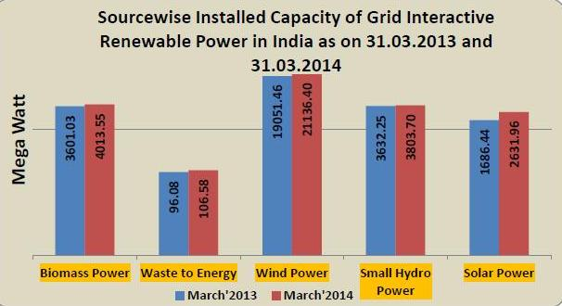
The total installed capacity of grid interactive renewable power, which was 28067.26 MW as on 31.03.2013 had gone up to 31692.18 MW as on 31.03.2014 indicating growth of 12.92% during the period .
Out of the total installed generation capacity of renewable power as on 31-03-2014, Wind power accounted for about 66.69%, followed by Biomass power (12.66%) and Small hydro power (12%).

Slide 11
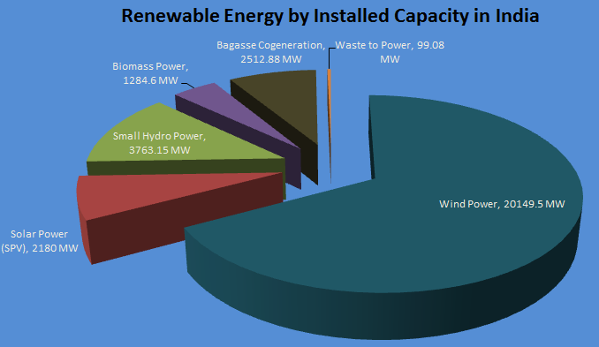
The present assessment of the potential of non-conventional source of energy and their present status of development are in fig.

Slide 12
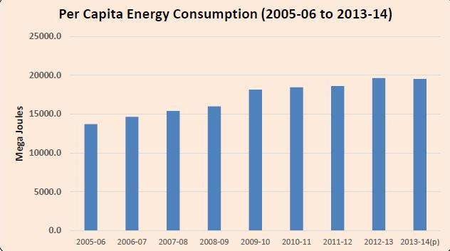
The total consumption of energy from conventional sources increased from 23,903 Peta joules during 2012-13 to 24,071 Peta joules during 2013-14, showing an increase of 0.70%
Per-capita Energy Consumption (PEC) (the ratio of the estimate of total energy consumption during the year to the estimated mid-year population of that year) increased from 13694.83 Mega Joules in 2005-06 to 19522.15 Mega Joules in 2013-14, a CAGR of 4.53% .

Slide 13
India's Renewable Energy Future Prospects
India stands among top five countries in the world in terms of renewable energy.
The installed base is 9% of total power generation capacity & contribute 3% to the electricity mix.
India occupies 5th position in the world in wind energy, Hydro projects upto 25 MW capacity.
In Nov. 2009 GOI approved National solar Mission which aims to enable 20000 MW to be dployed in India by 2022.
The GOI has set a capacity addition target of 30 GW which will take the total renewable capacity to almost 55 GW by the end of 2017.
This include 15 GW from wind power, 10 GW from solar power, 2.9 GW from biomass power & 2.1 GW from small Hydro power.
The Jawaharlal Nehru National solar mission aims to generate 20000 MW of solar power by 2022.

Slide 14
Energy Scenario up to the Year 2020
India plan to add 100GW of solar power capacity by 2022.
The country has five nuclear reactors under construction (third highest in the world) and plans to construct 18 additional nuclear reactors (second highest in the world) by 2025.
Study said India’s energy demand would grow from 691 million tonneof oil equivalent (mtoe) in 2010 to 1,500 mtoe in 2030
By 2016-2017, total domestic energy production of 670 million tons of oil equivalent (MTOE).

Slide 15
Estimates of Energy Requirement up to the Year 2020
The electrical energy demand for 2016–17 is expected to be at least 1,392 TWH.
The electrical energy demand for 2021–22 is expected to be at least 1,915 TWH.
Import of primary energy requirements will rise from 35 percent in 2014 to 51 per cent in 2030.
Due to rapid growth of automobiles, the demand for petroleum products will expected to rise to more than 240 million metric tonne by 2021-22 .
As per the Planning Commission report it is expected that demand for coal will rise to around 937 million tonne by 2021-22.
Demand for gas to be between 65 and 71 Billion Cubic Metres (BCM) for the year 2020.

Slide 16
Conclusions
Energy is vital for development and this means that if India is to move to a higher growth trajectory than is now feasible, it must ensure the reliable availability of energy. The present energy scenario in India is not satisfactory.
As per my analysis it is not possible for India to achieve energy security by concentrating on non renewable sources like coal and oil as the world does not have enough of such resources to meet demands which are continually increasing.
India’s target of getting around 15.9% of total energy need from renewable sources by 2022 is too modest.
India needs to realize the vast potential of renewable energy and need to step up effort for attaining the goal of vision 2020.

Slide 17
Reference
Central Electrical Authority
Ministry of New & Renewable Energy
Energy Statistics-2015
http://www.coal.nic.in
Ministry of Petroleum & Natural Gas Government of India New Delhi (Economic Division)
Planning commission of India

